Slide 1
Amazon Web Services

Slide 2
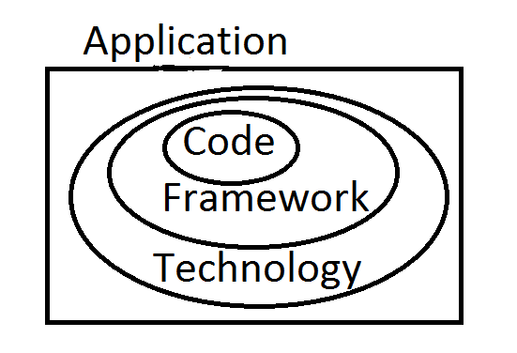
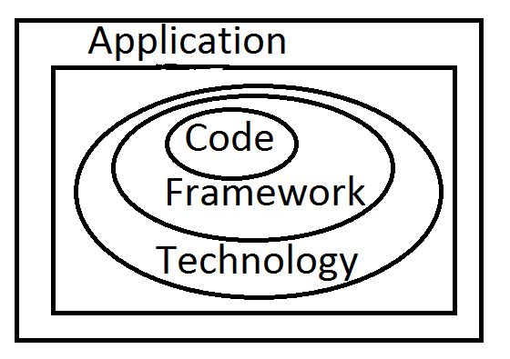
Data Center

Slide 3
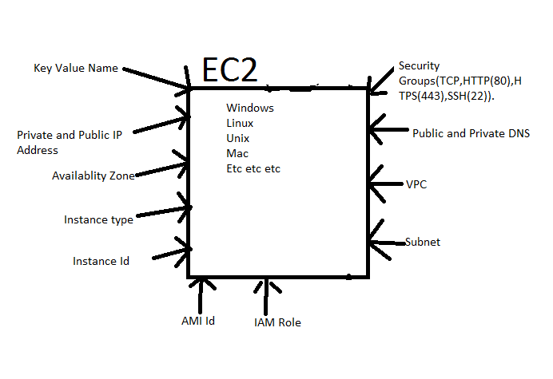

Slide 4
Client Request
Elastic Load Balance
EC2
CPU utilization
RAM Capacity
ROM Capacity
Hard Disk Capacity
Etc etc

Slide 5
Client Request
Elastic load Balance
Auto Scaling Group
EC2
EC2
EC2

Slide 6
Client East
Route53
Elastic Load Balance
Auto Scaling Group
EC2
EC2
Client West
EC2

Slide 7
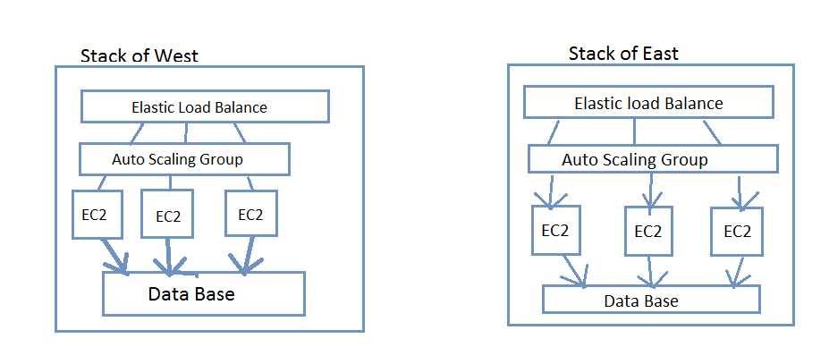
Client West
Client East
Route 53
Auto Sinking

Slide 8
Client West
Client East
WAF
Route 53
Auto Sinking
Auto Sinking

